Slide 1
FILE TRANSFER USING JAVA NETWORK PROGRAMMNG

Slide 2
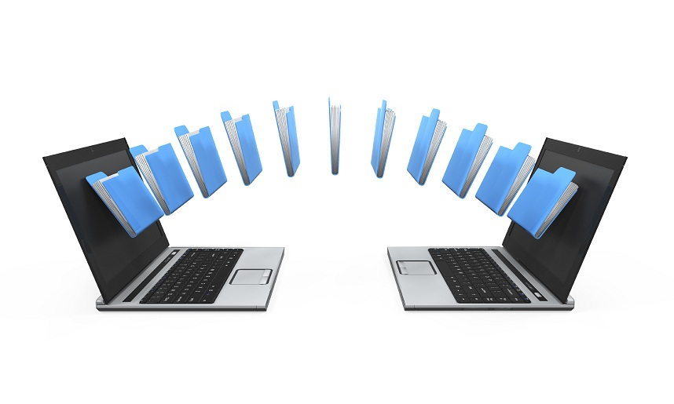
FILE TRANSFERRING BETWEEN TWO PC’S
Inorder to share files between PC’s there are many ways they are,
_By using Onedrive
_External hard drive.
_Transfer cable
_Pcmover etc.

Slide 3
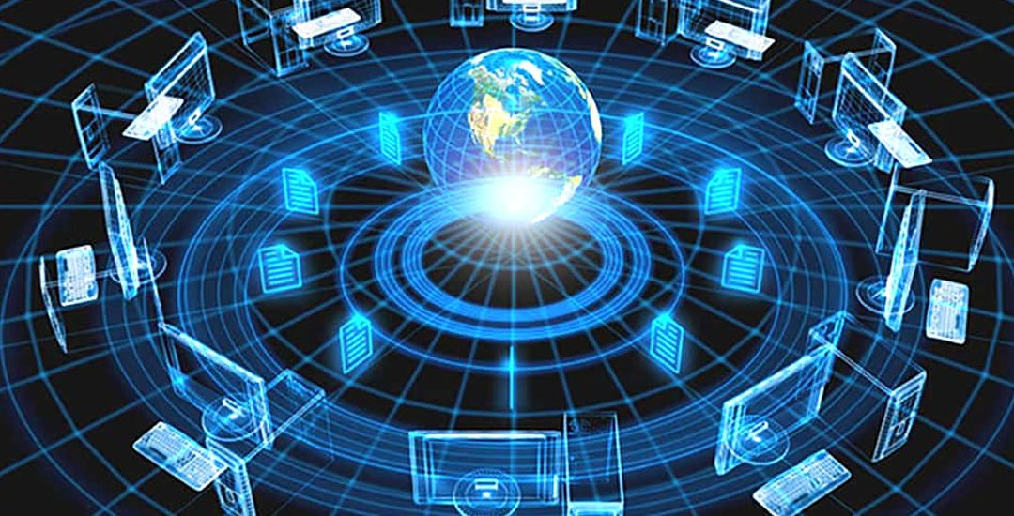
NETWORKING
Computer networking is a method of transporting and exchanging data or files over a network in an information system. It enables devices to be connected on small to a larger area network

Slide 4
OBJECTIVES
Java provides higher level of abstraction than C/C++
Things are automatically done.
Enables communication between sockets and wireless communication.
Provides more and more security for files

Slide 5
SOCKET PROGRAMMING
The ultimate aim of this project is to transfer the files from one PC to another using encryption with the help of “SECURE SOCKETS LAYER”.
The client server architecture is used to send and receive a file using sockets made with socket programming.
The procedure is same for file sharing in same/different computers.

Slide 6
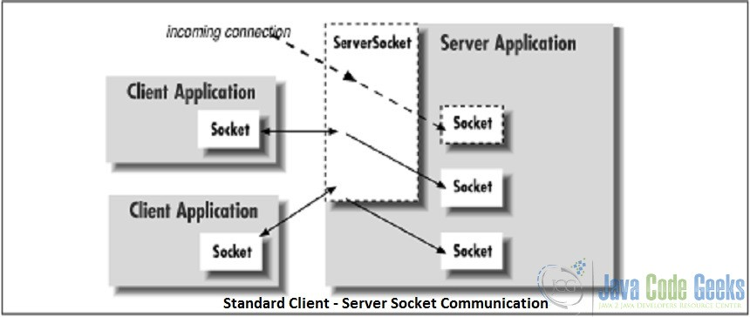
SYSTEM ARCHITECTURE

Slide 7
MERITS
Computers on different platforms can also communicate through sockets.
The system ensures that the exchanged data is not viewed by other person other than the receiver.
It ensures integrity ensuring that the data is not modified over the internet.

Slide 8
DEMERITS
Only packets of raw data can be send through socket based communication. To mechanism to make the data useful should be provided by both client-side and sever-side.
Security restrictions are sometimes not possible in Java Applet running in a browser.

Slide 9
CONCLUSION
Sometimes the special packet sniffers also accept the transferred data which becomes unsecure. This system overcomes such problem since before transferring the file is encrypted which in turn returns only the garbage content to the sniffers but not the actual content.

